Slide 1
Why is Data Literacy Important?
Understanding technology is less important than understanding data
Pick the right tool for the user and use case
Self-service analytics (aka “data democratization”, “data literacy”, or “data fluency”) initiatives at most companies are “underwhelming”
Your users’ level of data literacy (the ability to find, work with, analyze, and “discuss” data is critical to building a self-service, insights-driven culture
It is my ambition to help you better integrate business analytics into the decision-making process, and brandish it for competitive advantage.
Notes:
talent density: Reed Hastings

Slide 2
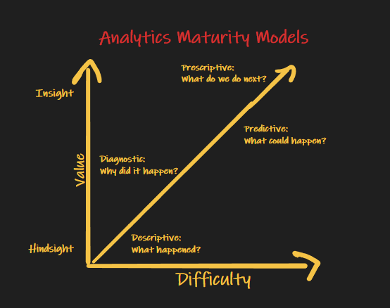

Slide 3
How The Industry Has Traditionally Done Data Projects…

Slide 4
Business Problem
“We spend $10M every month on Facebook ad campaigns? Should we spend more or less”
Process:
“If I could provide you with an answer, what would the UX look like”
What is the current ROI?
What data will I need?
How do I attribute sales to a given campaign?

Slide 5


Slide 6
Path Dependency Thinking (how we did it in the past…)
The Philosophy: Model data » Transform data » Load data » Understand data

Slide 7
Data Projects have a high fail rate
Too much time is spent in:
Requirements gathering
Data modeling
ETL
Users only see the fruits of the endeavor after the reports are created
In 2014, the Project Management Institute (PMI) released its
Pulse of the Profession report. PMI found that “37 percent of
all organizations reported inaccurate requirements as the
primary reason for project failure.”
https://www.pmi.org/learning/library/poor-requirements-management-source-failed-projects-9341
Gather Requirements
Model Data
Create Report
Distribute to Users
Complete & Begin Again

Slide 8
How a Data Scientist Thinks
Design
Thinking
A robust and well-proven methodology.
Data science-like.
Iterative.
Stresses up-front understanding of data.
Modeling is done later in the process (schema-on-read).
ETL might not be needed
Business Understanding
Exploratory Data Analytics
Deployment
Evaluation
Data Governance
Data
Modeling
Visualize
Operationalization

Slide 9
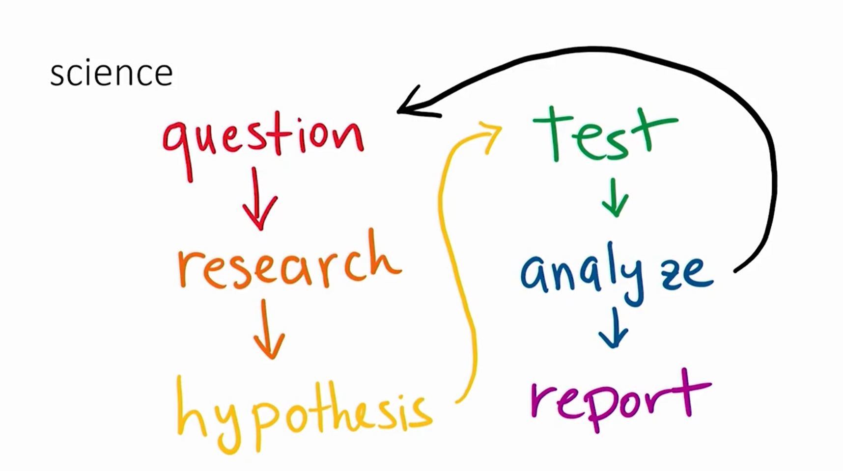
Notes:
Data Science Loop of Sadness
Deductive Reasoning

Slide 10
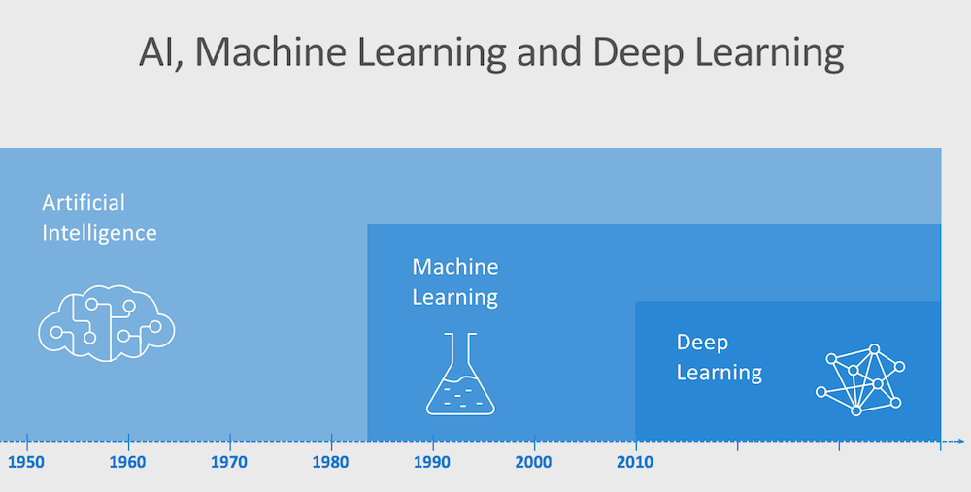
Notes:
Any system that mimics human behavior
Decision trees
Expert systems
AI winter due to hype, lack of data and compute
---
Data mining
And lots of data
Math to improve the data
Features and labels
---
Take a stack of algos and apply math
NNs
“layers”

Slide 11
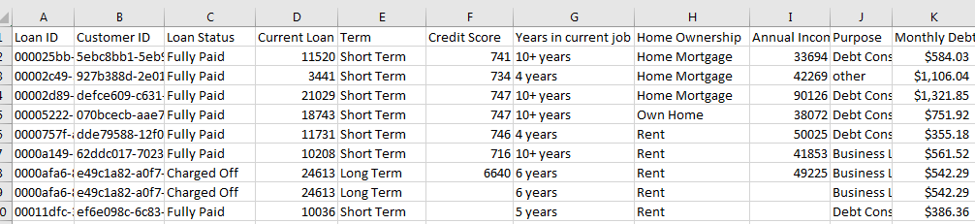
Understanding the “Shape” of Data Thinking Like a Data Scientist
Will this loan be charged off?

Slide 12
Terminology
Training Data : A set of samples (table of data)
Testing Data: A set of samples (training data) set aside to test your model
Features: Individual columns in our data set. These might be used to help make our prediction, or not.
Factors: aka features
Categorical Features: features with a known domain of values
independent variables: aka features
Feature Engineering: manipulating existing data to make it more meaningful
very similar to ETL
Data Wrangling/Munging: ETL
Data Dredging: make the data fit the hypothesis (don’t do this)
Label: Historical outcome or result related to a set of samples.
What you are trying to predict.
aka, “the target” or “the dependent variable”, or “response”
Notes:
Spurious correlations
annual income by education level (not understanding control variables)
golf causes more health problems (again, not controlling for age).

Slide 13

But, how do I get started on my first use case?
One way, set aside a bit of budget to test something a bit weird. Maybe the opposite of what you think is actually true?
Don’t worry if an experiment doesn’t replicate. Most experiments will not replicate every time.
You don’t have to be right all the time. That’s what an academic does, not a business person.
You don’t always need robust data. It isn’t physics. You just want to try something you wouldn’t otherwise try. If the cost of failure is low, then why not try something different?
If you test counterintuitive things, it’s much more valuable when they pay off because your competitors aren’t already doing those things.
Notes:
null hypothesis/counter factual
notice there is a general theme here: fail-fast, rp, design thinking
be curious
be innovative
examples of something a bit weird:
Airbnb: you want to have strangers in your home?
maybe price optimization/demand pricing is WRONG
supply chain with toilet paper
uber during dubai terrorism attack
go to next slide...

Slide 14
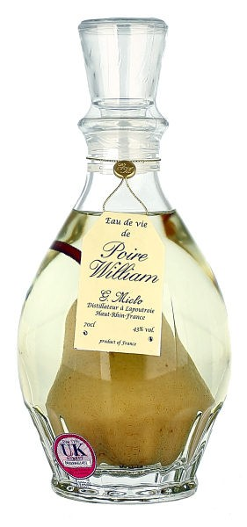
How to put a pear inside a bottle?
If the Question is wrong…
… the solution will never be right

Slide 15
How to get a bottle with a pear inside?
Notes:
we don’t use the word “put”
put the bottle onto the tree

Slide 16


Slide 17
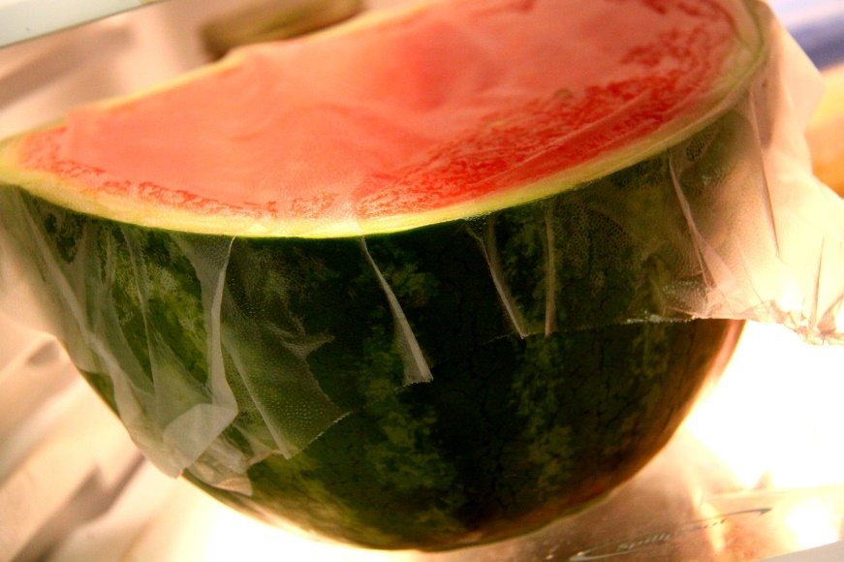
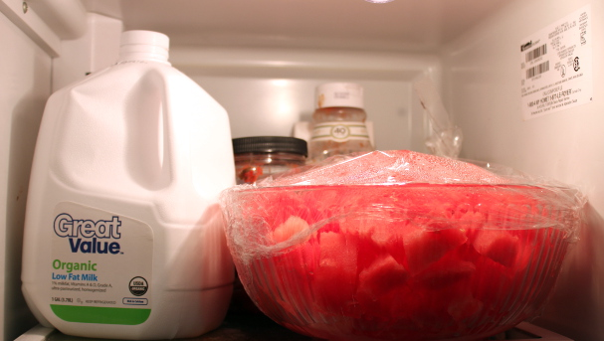
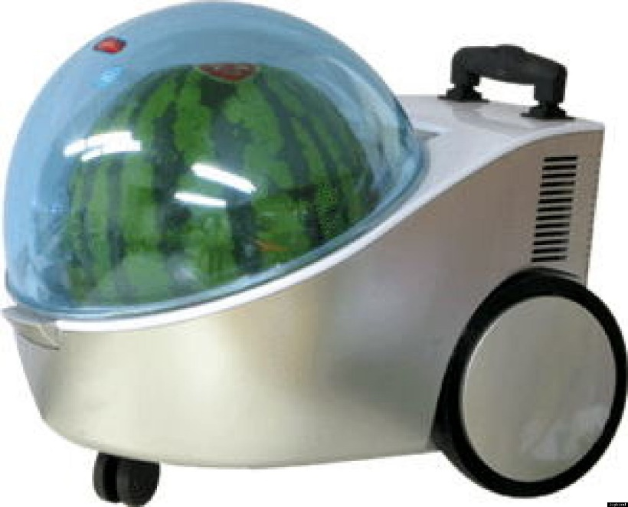
How to keep a watermelon cold?
Notes:
engineers will solve this in a somewhat ridiculous method

Slide 18
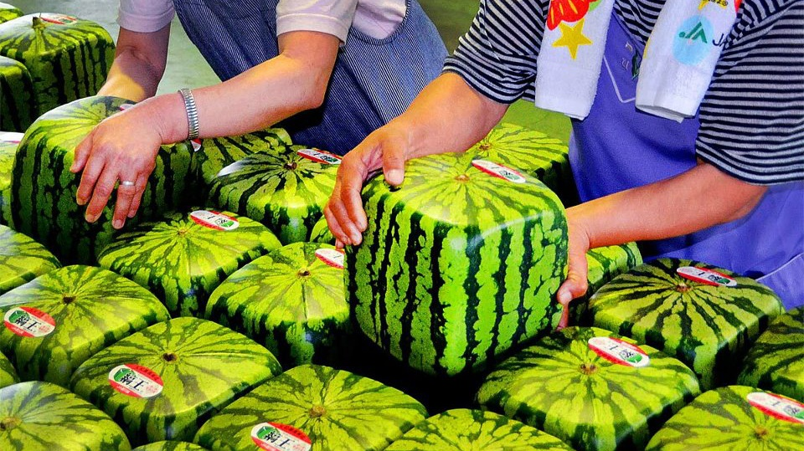
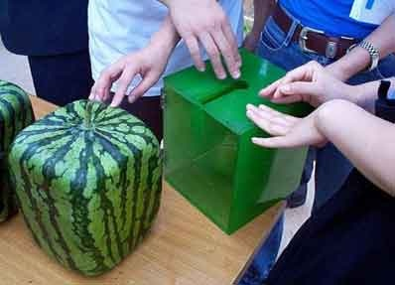
Notes:
this is a Japanese watermelon

Slide 19
Avoiding Cognitive Mistakes With Data

Slide 20
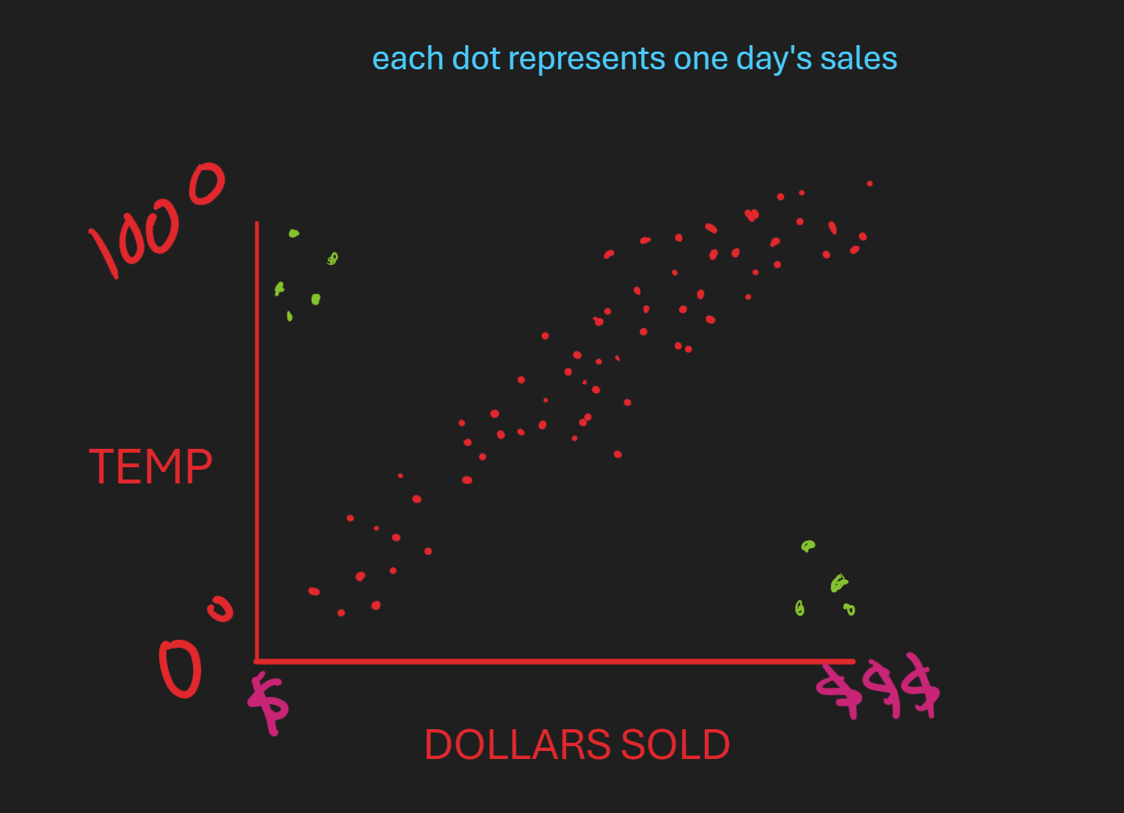
Don’t Make This mistake!
Many data scientists will make this mistake.
…don’t rush to build a predictive model without understanding the data.
…an example
Business Problem: We are a convenience store. We believe that as temperatures rise we can sell more ice cream. Therefore, if we know what the temperature is NEXT WEEK, we can reconfigure our freezers to carry more ice cream.

Slide 21
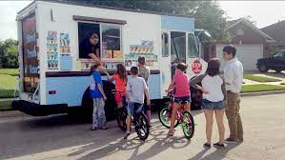
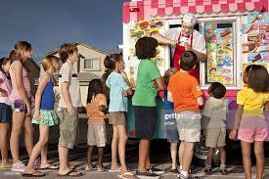
Why did this fail?
The convenience store didn’t take the outliers into consideration.
These are known as “confounders”
In data science, a confounding variable is a variable that can affect the relationship between other variables (in this case, “temperature” and “dollars sold”), leading to distorted or unreliable results.
As I like to say, “Humans are confounding!!”
So, what happened? What is the “confounder”?

Slide 22
Always remember: Data Scientists understand math, statistics, building predictive models, etc. But rarely do data scientists understand the business domain (ie, the problem). That’s where YOU can likely do it better. Here’s an example:

Slide 23
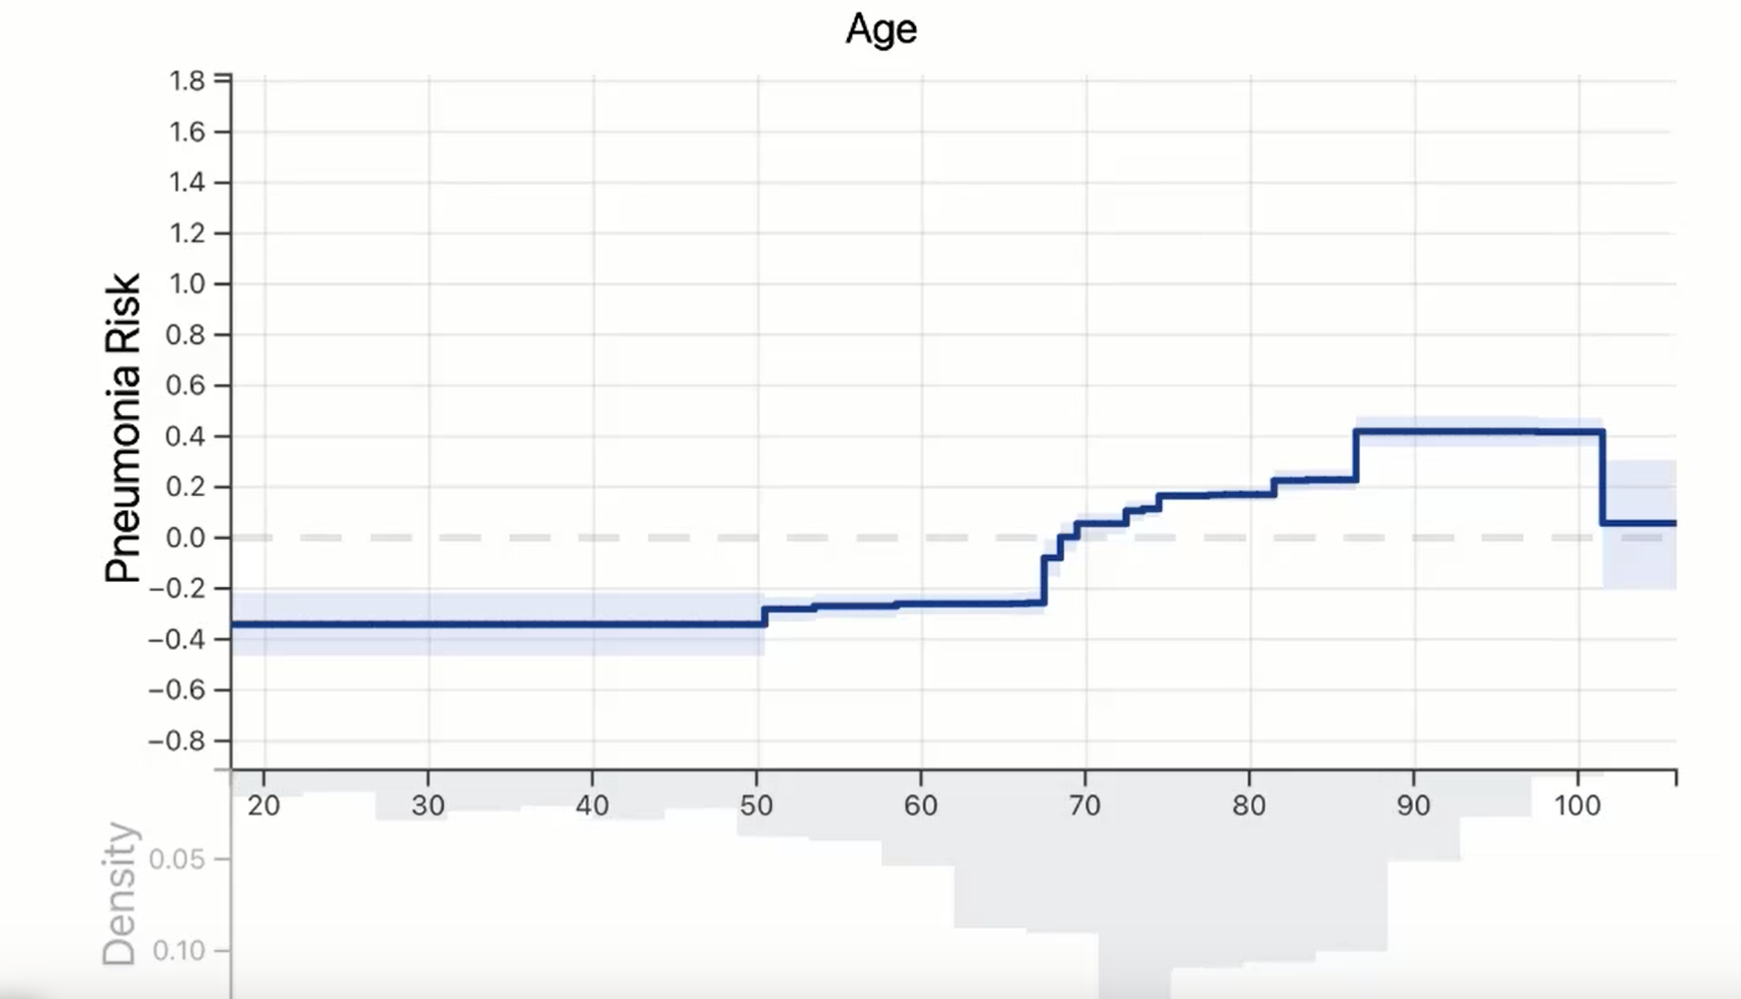
Notes:
Will the pt die or survive from pneumonia?
Pneum risk: positive = higher risk of death. Negative = lower risk of death
Sudden increase between 60-70. why? What’s the hypothesis? Retirement?
Again increase around 86. Why? Too conservative of a treatment?
Why the drop at 100 yo?
basically at 101 yo they have the sasme risk as someone 71 yo
makes no sense
the algorithm had no data so it imputed the missing value to be the mean of the whole. ouch

Slide 24
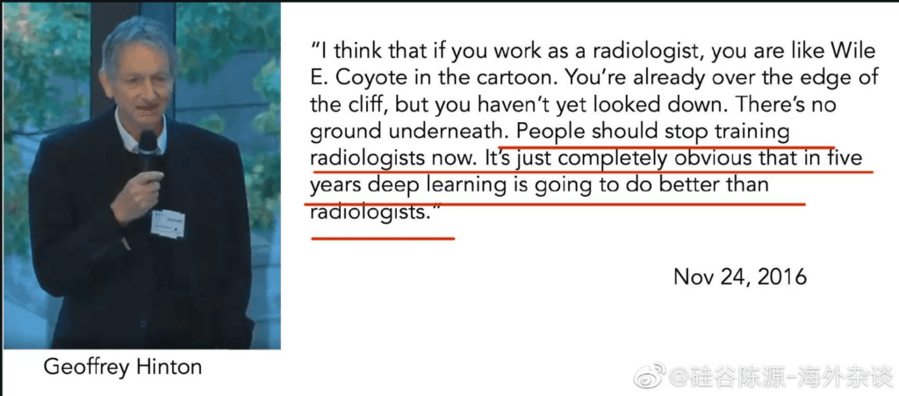
Notes:
we should learn from Einstein, who when offered the presidency of Israel, wisely declined citing lack of experience and aptitude. In other words, experience in deep learning does not give AI experts expertise over other professions.

Slide 25
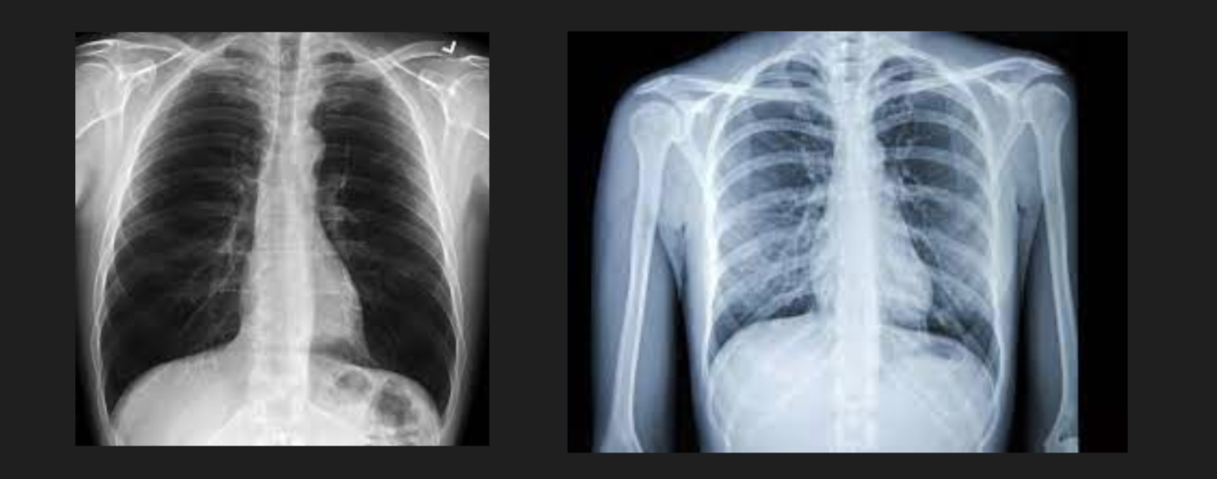
Model Evaluation: Accuracy may not be the most important thing

Slide 26
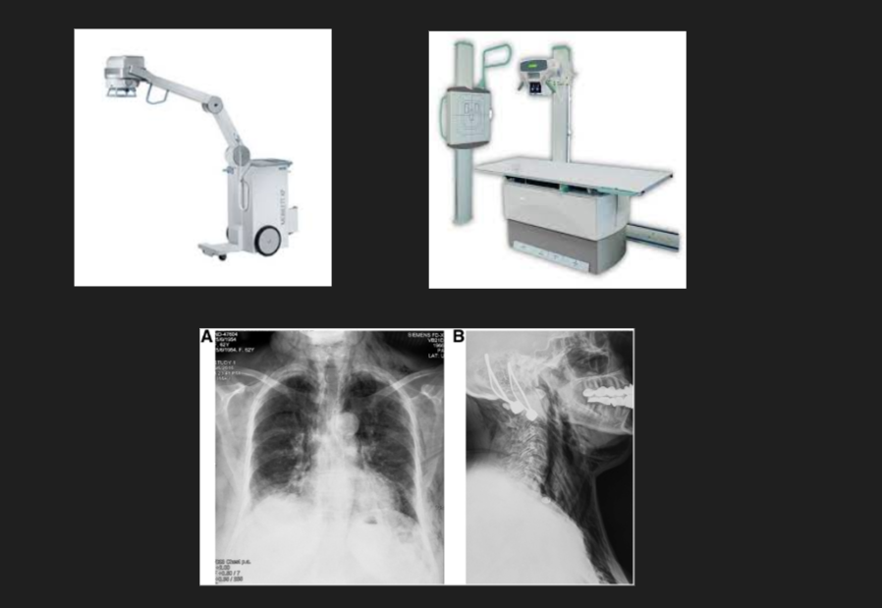

Slide 27
“We have a problem with customer loyalty”
“Our best customers (top 10%) in 2023 bought 30% less in 2022”
This might be a “regression to the mean” problem
Notes:
the analyst is taking this message to the CEO.
is this really a problem?
The Top 10% is already an extreme so you would expect them to be closer to the average and further from the extreme the next year.
Consider looking at the last few years instead to prove this.
Regression to the Mean

Slide 28
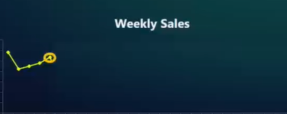
“Sales have increased for the past 4 weeks. We’re on an upswing!!”
Is this a valid conclusion?

Slide 29
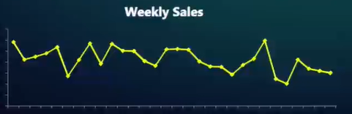
“Sales have increased for the past 4 weeks. We’re on an upswing!!”
Is this a valid conclusion?
this is an issue of “spotting trends too early”
Notes:
this is a random sequence.
Here we get 8 runs up or down of 4 or more.
Probabilities state that with random numbers we can expect to get a run of 4 up or down 25% of the time.

Slide 30

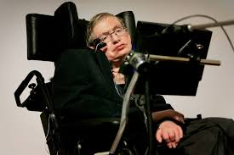
Learning Something That Isn’t True
“Superstitious learning occurs when the connection between the cause of an action and the outcomes experienced aren’t clear or misattributed.”
This can be due to:
regression to the mean issues (Issue 1)
trends that are really random (Issue 2)
causation inferred from correlation
faulty case studies (“one-off occurrences”)
Notes:
Stephen hawking: the greatest enemy of knowledge isn’t ignorance, it’s the illusion of knowledge.
People use statistics like a drunk uses a lamppost...more for support than illumination.
case studies: be careful trying to learn from case studies or inferring trends or trying to generalize them
why was _this_ salesperson so successful last quarter?
it must have been her contact strategy, presentation style, etc
what made this project more successful than the previous projects?
it was the right time
this is a common approach used by
business schools
best-selling authors
spurious correlations

Slide 31
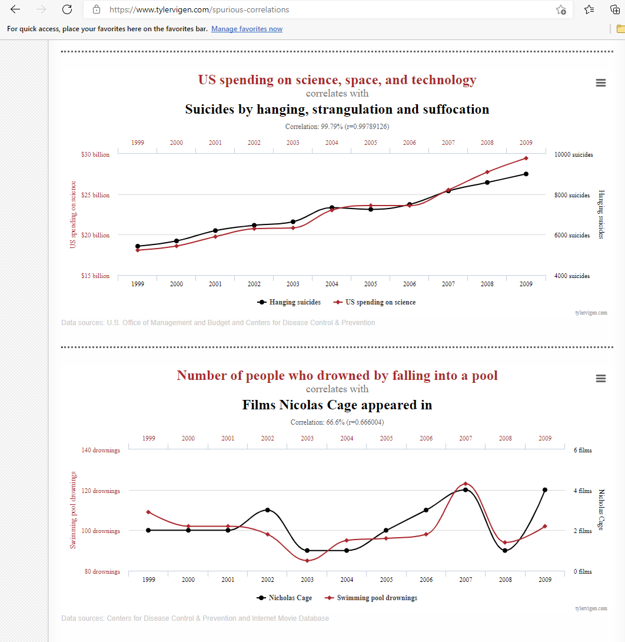

Slide 32
A statistically significant correlation between two variables may be due to:
chance
the usual statistical significance burden of proof is 5%. If there is no relationship between 2 variables then we would be concluding there IS a statistical significance 1 in 20 times.
If you look at relationships among 15 variables (by looking at pairs), 5 correlations will be statistically significant simply by chance.
underlying (hidden) factor
a true cause-effect relationship (but which causes which)
Notes:
hidden factor
it could just be a trend over time

Slide 33
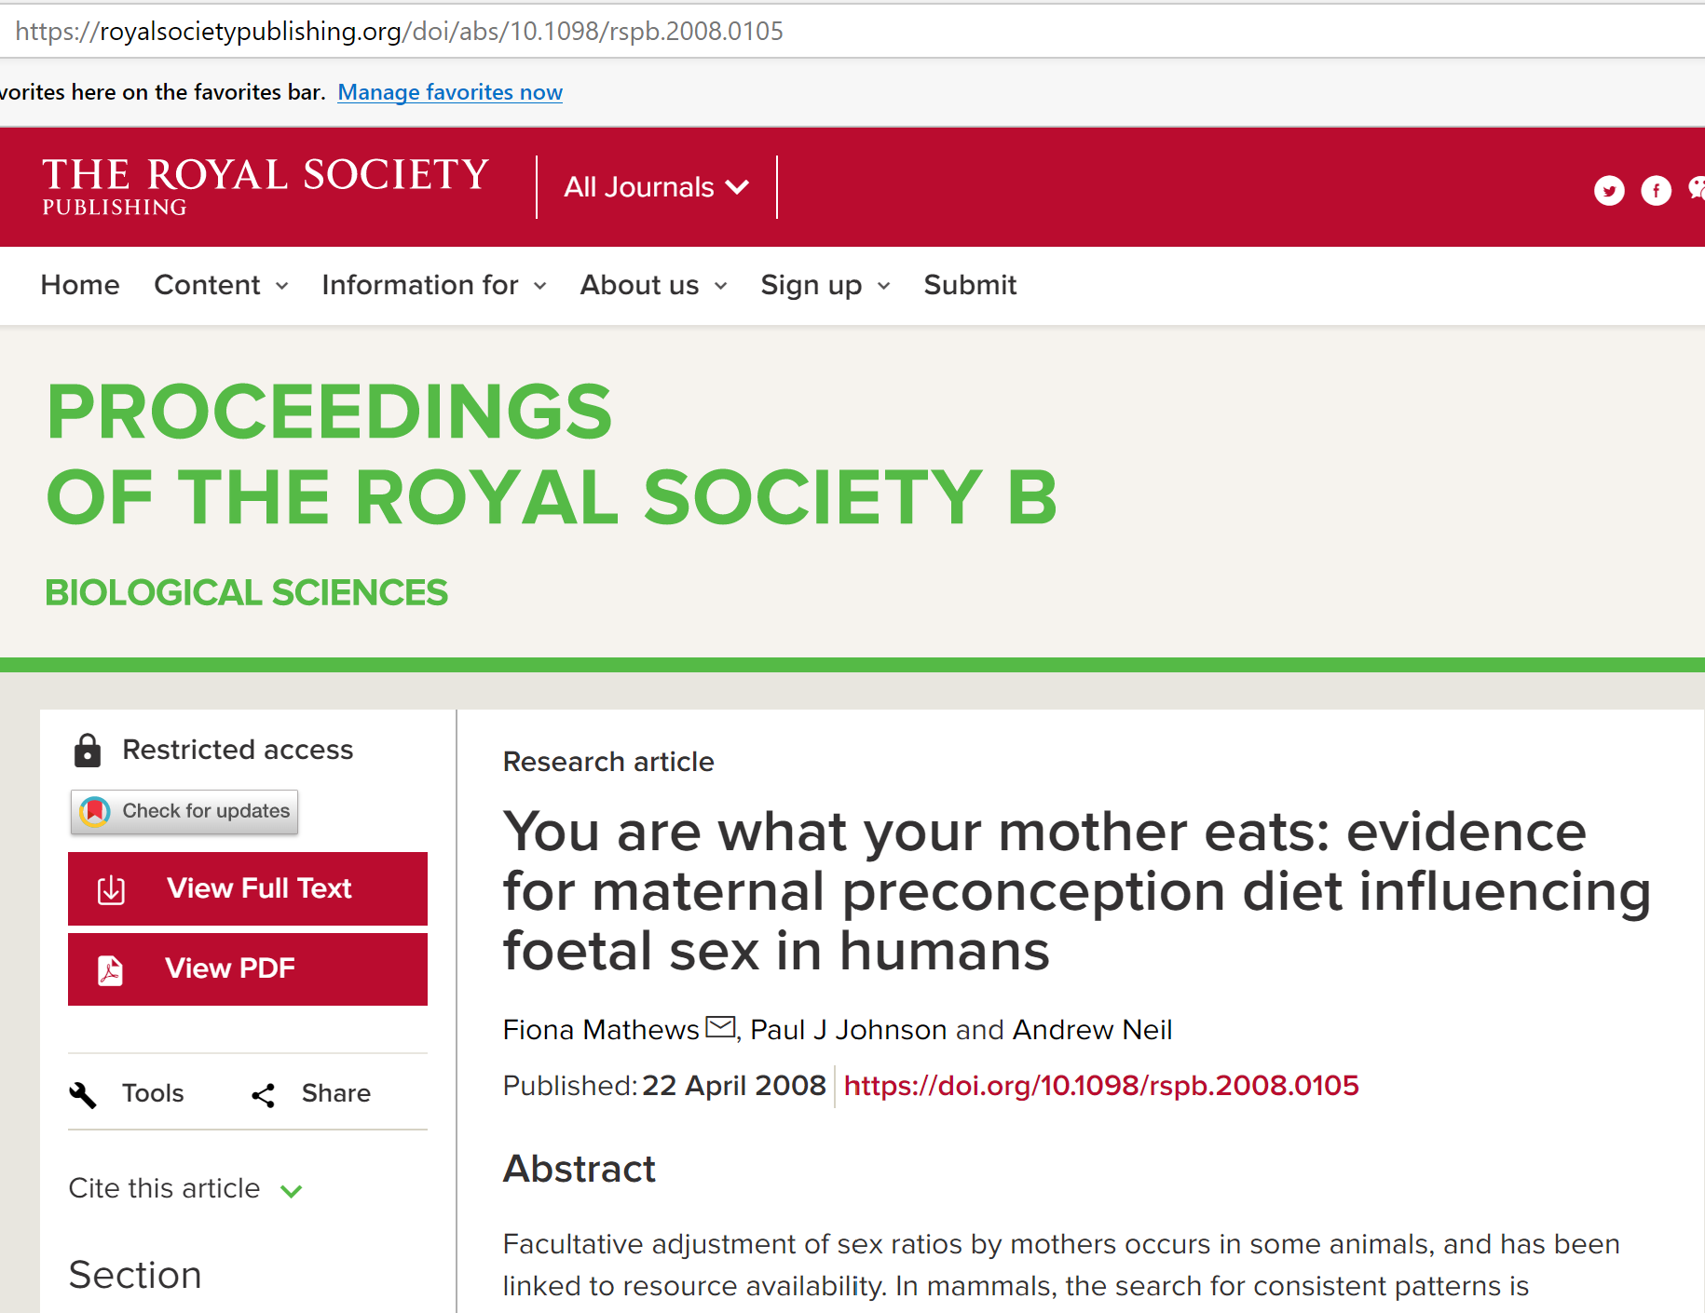
Most observational studies tend to be wrong
In business, we rarely expect academic excellence in our studies...but we should at least be aware of our possible cognitive shortcomings.
Notes:
What is an ML algorithm? A search for correlations and their weightings.
Most of what we do are observational studies. We have some data, we look for the most highly correlated data, and we assume that is most predictive. We need to be careful here.
Look at the research paper. They found correlations. Now mainstream media takes the headline and adjusts it to fit their narrative: “Want a bouncing baby boy? Eat your cheerios.”
Observational medical studies are almost always wrong and tend to be the most touted in the media. Example: a medical journal claimed if a woman wants to have a male son, eat cereal for breakfast.
pregnant woman given a 300 question survey
researchers looked for statistically significant correlations.
at 5% as the standard we expect they found about 15 statistically significant correlations.
now they look for the most stat sig and it was eating cereal for breakfast.
what they should’ve done is try to replicate the claim by doing a CLINICAL TRIAL
this is called data dredging
look at 20K features: which are most correlated? did the customer change their address?
call center transcriptions: using the word “God”
Top Down (deductive) : theory, hypothesis, observation, confirmation
Bottom up (inductive) : observation up. This is ADL

Slide 34
Standard Deviation Helps Confirm Your Intuition
Your CMO presents a new ad campaign and claims it will increase sales to $570/mo. That seems aggressive. What is the likelihood of this happening?
Year | Avg Monthly Sales | Min | Max
2023 | 500 | 480 | 520
2022 | ... | ... | ...
2021 | ... | ... | ...
StdDev “Shortcut” = (MAX-MIN)/4 = 10
Now you can use stddev to calculate the “Z-Score”.
z-score = how far you are from the mean = (x – mean)/stddev
Example: Assume Jan 2024 = 510. z-score = (510-500)/10 = 1 stddev
What is the CMO forecast? (570-500)/10 = 7 stddev
Generally accepted principle: zscore > 3 is an outlier and not likely
Notes:
for me, standard deviation can be used to confirm intuition.
Ask your CMO: “How did you arrive at that number?”
you are given avg sales data for the previous few years
don’t get caught up in the formula for std dev. A quick conservative estimate is (MAX-MIN)/4. It works very well regardless of the distribution of the data.
so std deviation = 10
z-score is how many standard deviations away a number is from the mean (500).
It is generally accepted that a zscore >3 is considered an outlier and not very likely. The CMO’s forecast is 7 stddevs. This claim should definitely be challenged and doesn’t seem right intuitively.
But you don’t even need zscores and std devs to see this. If you bar chart the monthly average sales you will quickly see that sales are very stable and plotting the 570 would be a huge outlier. This is far more intuitive.

Slide 35

Let’s change the Historical Data and Look at it Again
Your CMO presents a new ad campaign and claims it will increase sales to $570/mo. That seems aggressive. What is the likelihood of this happening?
Year | Avg Monthly Sales | Min | Max
2018 | 500 | 480 400 | 520 600
2017 | ... | ... | ...
2016 | ... | ... | ...
StdDev = (MAX-MIN)/4 = (600-400)/4 = 50
z-score = (x – mean)/stddev
NOW what is the CMO forecast?
(570-500)/50 = 70/50 = 1.4 std dev
Z-scores
>3
1.65-3
< 1.65
Notes:
Only change is the historical sales numbers
let’s work the approximations
1.4 is definitely possible.
Again, if you think about a bar chart of the avg monthly sales your mind’s eye can see a wider spread of data, and the 570 definitely would not be an outlier in this case.
Use the zscore as a traffic light. It’s just an approx. but works in most cases

Slide 36
How Business Leaders Can Avoid Analytics Mistakes
Data Scientists tend to be well-versed in math, probabilities, and statistics.
Even so, humans in general are susceptible to cognitive biases, especially when interpreting data
Especially “conditional probabilities” (the likelihood of an event happening)
Trust your intuition
Don’t be fooled by randomness
Always get feedback from other people (design thinking)
Quantitative methods can tell you WHAT or HOW, but never WHY

Slide 37
I CAN’T DO THIS. I’m scared. This is too much math!

Slide 38
Github Repo
Presentation, examples using Jupyter notebooks, add’l material
https://github.com/davew-msft/datacamp-dl
linkedin.com/in/dwentzel

